Slide 1
Enabling
The Fine Line Between Helping and Hurting
Nancy L Johnston, LPC, LSATP, MAC
nancyljohnston.com
October 21, 2020
VSIAS 2020 Virtual

Slide 2
Introductions
Welcome to this workshop
Today we will be considering Enabling, and we will be studying that behavior beyond the definitions we all know and understand.
Our intent will be to go deeper within our self and develop an Internal Compass that can help us detect the Fine Line between Helping and Hurting.

Slide 3
Introductions
We will be examining this Fine Line
In our personal life
In our professional life
With our clients
For our clients (they can use this material, too)
With our organization
A bit about me

Slide 4
You and this Workshop
What are your reasons for choosing this workshop?
What do you hope to learn in this workshop?
As we start, can you identify one person in your life who challenges your fine line between helping and hurting? This could be family, friend, client, or co-worker.

Slide 5
You and this Workshop

Slide 6
Learning Objective #1
Develop a basic understanding of Enabling – what it looks like and why we do it.

Slide 7
Basic Definitions (Central Recovery Press, 2017)
Enabling is the providing of help and support that perpetuates another person’s problem(s) rather than solves it.
This help and support may be in the form of taking responsibility or blame for another person’s destructive behaviors or making special accommodations for them.

Slide 8
Basic Definitions
Enabling allows a person’s problem(s) to continue and worsen.
Enabling allows the person to not take responsibility for their behaviors.
Enabling keeps the other person from experiencing the consequences of their problem(s).

Slide 9
Basic Definitions
Enabling often involves doing something for someone else that they could and should do for themselves.

Slide 10
Forms of Enabling (Central Recovery Press, 2017)
Protecting from natural consequences
Rescuing
Making excuses
Rationalizing by explaining away the problem(s)

Slide 11
Forms of Enabling
Blaming others
Doing for the other person what they are capable of doing themselves
Giving money

Slide 12
Forms of Enabling
Threating but not following through on what has been said
Avoiding in order to keep the peace
Secret keeping, covering up lies

Slide 13
Why would we Enable? (Central Recovery Press, 2017)
To help someone we care about.
To avoid dealing with the difficulties and potential losses associated with the other person’s problem(s)
To control a situation which is out-of-control and/or to improve/fix that situation or person.

Slide 14
You and Enabling
Does enabling pose any challenges for you? Do you find it difficult to say “no” or to stick with a boundary you are trying to set? What else about you may contribute to enabling?
Are you aware of these challenges within you when they are happening?

Slide 16
Learning Objective #2
Understand the concept of the Fine Line between Helping and Hurting – a deeper look at Enabling

Slide 17
The Fine Line
As we look deeper at enabling, I propose that we are not looking for rules about what we can and cannot do for someone else.
Though the examples we just looked at give clear guidance for what may be enabling, for the most part each of us will have to decide if we are enabling or not.

Slide 18
The Fine Line
This is where developing our internal compass comes in.
Determining whether we are enabling someone else is done on a situation-by-situation basis and is decision-based within each of us using the information and models we will now be discussing in this session.

Slide 19
The Fine Line
As said in my Introduction, this material is offered to counselors, to the clients we serve, and to the organizations in which we work.
Learn this material first for you. Then you can share and teach it.

Slide 20
The Fine Line
Giving, fixing, and caregiving behaviors are offered usually with the intention of helping .
This helping can become harmful to the healthy development of both self and the other person if it goes too far.

Slide 21
The Fine Line
Our helpful behaviors can become enabling behaviors if they cause the other person to:
Not take responsibility for self.
Continue their destructive behaviors.
Not feel the consequences of their choices.
Perpetuate problems.
Not learn and grow.

Slide 22
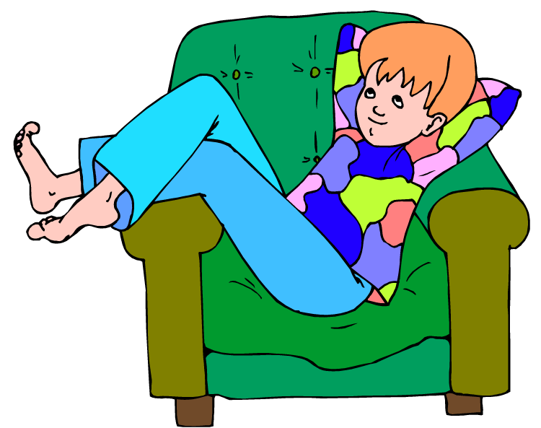

Slide 23
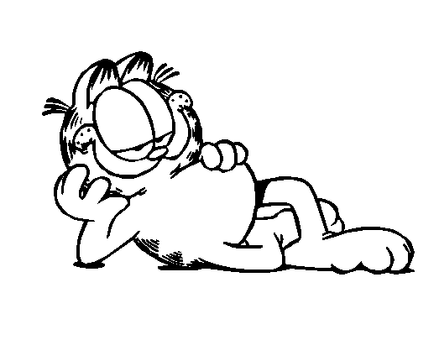

Slide 24
The Fine Line
The growth of the person enabling is also limited by their enabling behaviors:
They may remain stuck in their fixer/helper mode.
They may become:
Overwhelmed
Exhausted
Resentful.

Slide 27
The Fine Line
I describe these helping/hurting behaviors as:
Over-functioning for someone else
and
Under-functioning for self.

Slide 28
The Fine Line
As we learn to not over-function for someone else, let’s consider our helping, fixing, caregiving behaviors on a continuum from okay to going too far.

Slide 29
The Fine Line

Slide 30
Giving It All You’ve Got
Likely means going too far

Slide 31
Using the Continuum to find The Fine Line
With the continuum in mind, here are concrete examples of what may become enabling behaviors if we are not mindful:
Doing more then our share
Doing something for someone else when they said “no” to our offer

Slide 32
Using the Continuum to find The Fine Line
Doing something the other person is capable of doing
Thinking/problem-solving for others
Speaking for others

Slide 33
Using the Continuum to find The Fine Line
Covering up, making excuses, or lying for others
Taking over
Violating our own boundary previously set by us with someone else

Slide 34
You and the Fine Line
Let’s go back and look at some of the clip art in this section on the Fine Line:
What feelings and thoughts come up for you as you look at those pictures of the under-functioning person?
What feelings and thoughts come up for you as you look at those picture of the over-functioning person?

Slide 35
You and the Fine Line
Draw a continuum in the space below placing Okay on one end and Going Too Far on the other end. Now, place your self on the continuum as it applies to you when it comes to:

Slide 36
You and the Fine Line
Doing more than your share
Doing for others what they could do for themselves
Thinking/problem-solving for others
Taking over
Violating your own boundaries

Slide 37
You and the Fine Line
Looking at the picture at the end of this section where one individual is helping another over the wall:
What feelings come up for you as you look at this?
What challenges might exist as one individual helps another in this way?

Slide 38
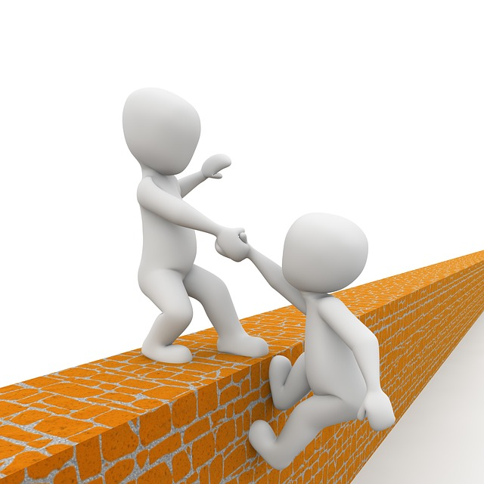

Slide 39
Learning Objective #3
Recognize signs that you are crossing the Fine Line from helping to hurting

Slide 40
Signs You are Near the Fine Line
Understanding there is a fine line between helping and hurting, here are some warning signs that you may be near that Fine Line.

Slide 41
Signs: Listen to and Observe Self
What are your feelings as you are offering help?
Irritation
Frustration
Exhaustion
Hopelessness

Slide 43
Signs: Listen to and Observe Self
What are your thoughts as you are offering help?
Preoccupied with the other person
Negative judgments of them, of you

Slide 45
Signs: Listen to and Observe Self
What are your behaviors as you are offering help?
Compulsion to keep doing things which may help or change them
Taking action you said you would not take, e.g. trying again, offering again

Slide 46
Signs: Listen to and Observe Self
Taking action on what they said they will do
Taking action because you cannot stand to wait
Taking action because you cannot let it go

Slide 47
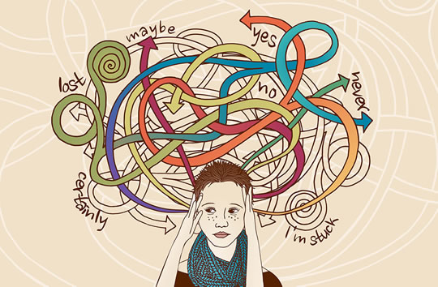

Slide 48
Signs: Listen to and Observe the Other Person
What feelings are they conveying to you?
They don’t care about what you are concerned about.
They don’t think it is important.
They are fearful or insecure about what they are trying to do.

Slide 49
What other feelings are they conveying to you?
They are resistant to your ideas.
They are becoming increasingly irritated by your efforts.
They express anger and blame you for what is wrong in their life.

Slide 50
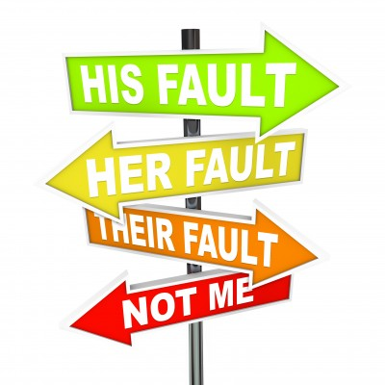

Slide 51
Signs: Listen to and Observe the Other Person
What thoughts are they expressing to you?
“I don’t want to.”
“Leave me alone.”
“This is not for me.”

Slide 52
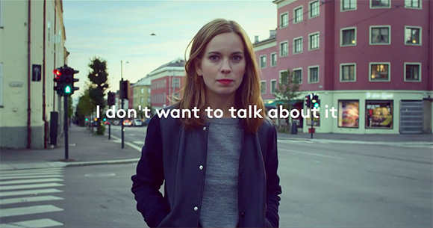

Slide 53
What other thoughts are they expressing to you?
“I can’t do it.”
“I don’t want to do it.”
“I can do it myself.”

Slide 54
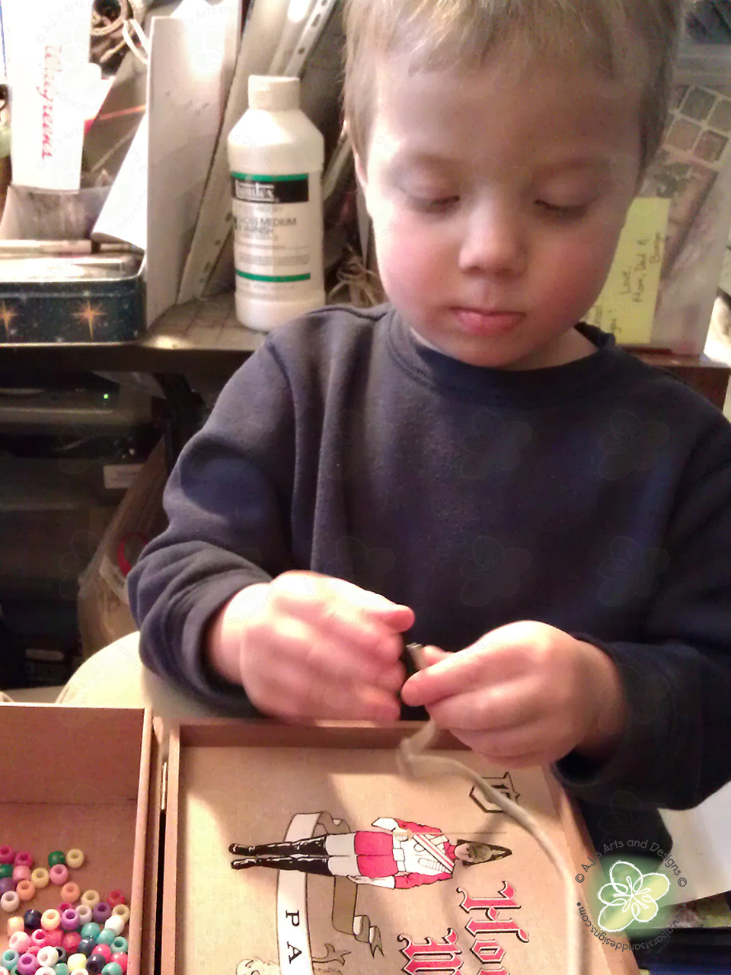

Slide 55
Signs: Listen to and Observe the Other Person
What behaviors/actions do you see from them?
Are they doing nothing?
Are they not following-up on what they said they would do?
Are they walking away from you?

Slide 56
What other behaviors/actions do you see from them?
Are they forgetting what they said they would do?
Are they waiting for money, help, or other resources from you?
Are they being slow to do anything?

Slide 57
What other behaviors/actions do you see from them?
Are they doing what they want to do for their self rather than what you want them to do?
And doing that in their own ways and time frames?

Slide 58
You and Signs You are Near the Fine Line
The Fine Line is where our feelings, thoughts, and behaviors are becoming stronger and making it difficult for us to stick with the limits we want to live with. We say and do things we have sworn we do not want to do. We move down the continuum of helping into the realm of hurting.
Self-awareness is essential to managing our placement on this helping/hurting continuum.

Slide 59
You and Signs You are Near the Fine Line
Listen to the case example presented. In response to that:
Put yourself in the mother’s position:
What would you be feeling?
What would you be thinking?
What might you be doing in reaction to what is going on?

Slide 60
You and Signs You are Near the Fine Line
Now put yourself in the son’s position:
What is he feeling?
What is he thinking?
What is he doing or not doing?
What might you do if you were the mother who wants to help and not hurt?

Slide 61
You and Signs You are Near the Fine Line
What are signs within you that you may be about to let go of a boundary you have previously set with someone?

Slide 64
Learning Objective #4
Learn strategies to stay on the helping side of the Fine Line.

Slide 65
Strategies for Staying on the Helpful Side of the Fine Line
At a fundamental level it is helpful to see and believe that we can go too far with helping and inadvertently hurt the person we are trying to help.

Slide 66
Strategies for Staying on the Helpful Side of the Fine Line
At a fundamental level we want to commit to acting in ways which foster the healthy development of self and other – which may mean changing our thoughts and behaviors and learning to manage uncomfortable feelings along the way.

Slide 68
Strategies for Staying on the Helpful Side of the Fine Line
Applying the following 10 ideas and skills sets can help us with our commitments to help not hurt:
Increased self-awareness as we are helping – noting feelings, thoughts, and behaviors

Slide 69
Strategies
Willingness to change our behaviors and learn to deal with the assortment of feelings and thoughts which may arise in us as we leave more for the other person to do

Slide 70
Strategies
Learning new skills and/or practicing ones we already know will be important as we stay in the helpful zone.

Slide 71
Strategies
Skill sets we will study here include:
Detaching
Frustration Tolerance
Anxiety Management
Boundary Setting

Slide 72
Strategies
But first, let’s anchor ourselves in 5 Core Skills that are involved in each of these skill sets.
These 5 Core Skills are foundational and can help us center our self and then tune in to what we really want to say and/or do.

Slide 73
Strategies
5 Core Skills
1- Pause or Stop
2- Mindful breathing
3- Quieting thoughts
4- Releasing body tension
5- Present moment awareness

Slide 75
You and Strategies
Of these 5 Core Skills which can help to calm us and connect with our self in healthy, productive ways, which skills appeal to you the most? Which ones work for you? What are other ways you calm your self?

Slide 77
Strategies
And then there are 3 Core Relationship Dynamics to be aware of as we try to offer the right amount of help and caregiving,
the amount that may benefit the other person but not disempower them,
the amount that we feel responsible for doing but stopping short of taking care of their responsibilities.

Slide 78
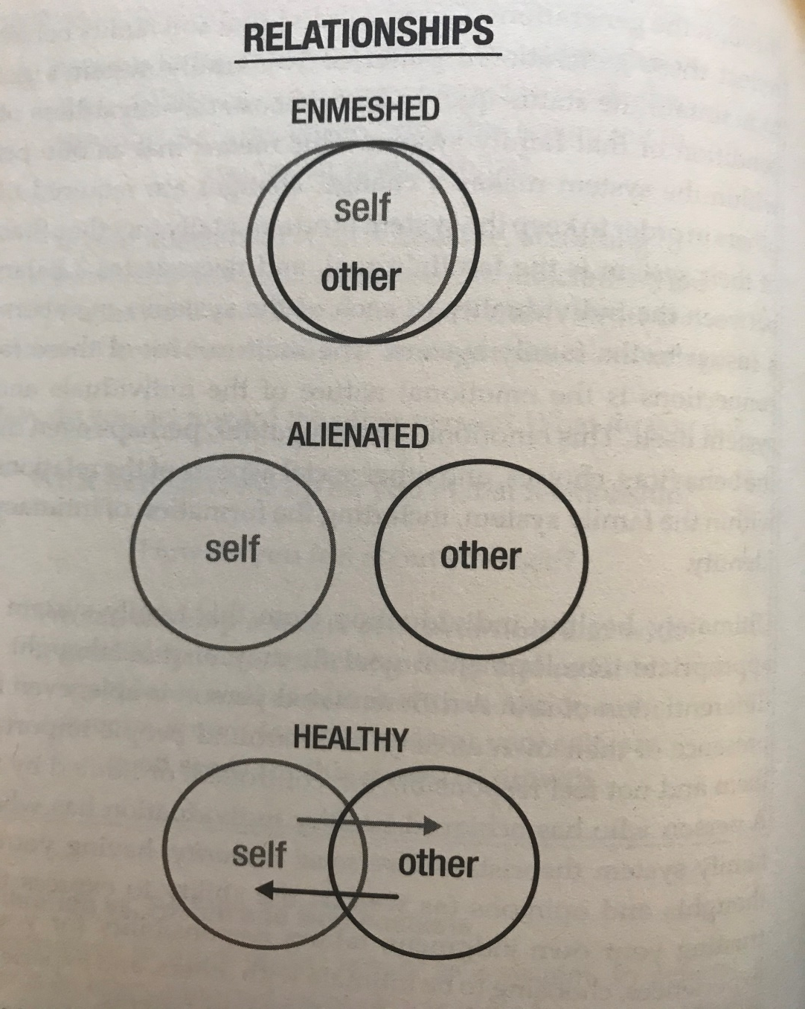

Slide 79
You and Strategies
As you consider these 3 Core Relationship Dynamics, are you more inclined toward one over the other: enmeshed, alienated, healthy/dynamic?
Thinking of the person you identified in question #3 who you feel challenged to help not hurt, what are your relationship dynamics like with that person?

Slide 80
You and Strategies
What can challenge you when you are trying to interact in a healthy/dynamic way? Consider how your feelings and thoughts, fears and worries, and/or your reactions to the other person may cause you to back down or do more.

Slide 82
Strategies – Detaching Skills
Detaching Skills: Learning to respond not react
Shift from reacting to responding
Find emotional balance so you can:
See the situation more clearly
Respond in a way that is true for you

Slide 83
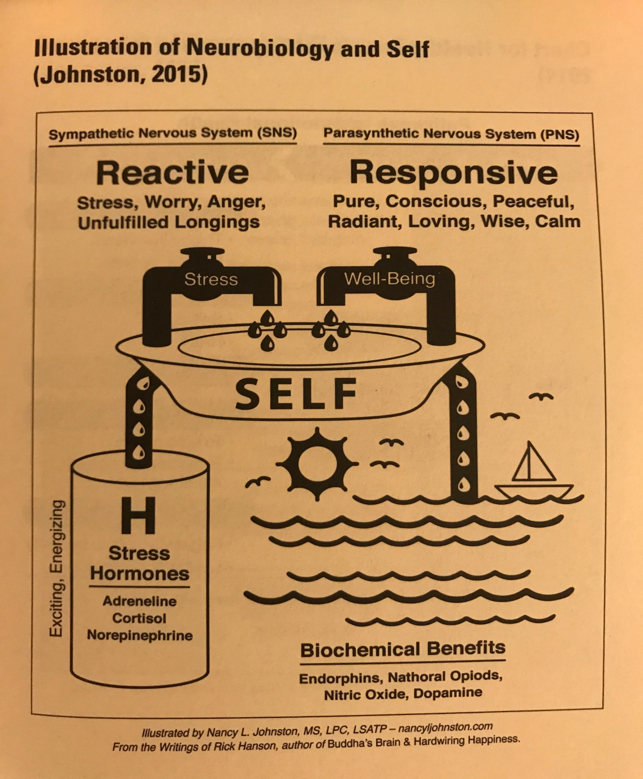

Slide 84
Strategies – Frustration Tolerance Skills
Frustration Tolerance Skills: Learning to live with uncomfortable feelings
Recognize uncomfortable feelings
Accept them nonjudgmentally
Acceptance does not equal approval
Acceptance can be fostered by mindfulness practices

Slide 85
Strategies – Frustration Tolerance Skills
Learn to bear pain successfully
Re-Focus
To present moment
To self, to other people
To other activities of your day
Relax
Mindfulness practices
What works for you

Slide 86
Strategies – Frustration Tolerance Skills
Re-Set
Connect with your reason
Apply Detaching Skills. Then, you can:
Remember your long-term goals for growth and health for all
Connect with your values
Connect with your spirituality

Slide 88
Strategies – Anxiety Management Skills
Anxiety Management: Learning to calm worry and fears
Use 5 Core Skills to calm and center self
Decrease worry and fears by:
Willingness
Use of Re-Focus skills employed with frustration tolerance
Use of CBT to correct thinking errors feeding obsessive thoughts and catastrophic thinking

Slide 89
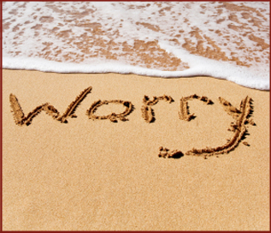

Slide 90
Strategies – Boundary Setting Skills
Boundary Setting: Learning where you end and the other person begins
Setting boundaries
Listening to your self
Thoughts
Feelings
Body
Spirit
Finding your “I” statement

Slide 91
Strategies – Boundary Setting Skills
Stating your boundaries assertively
Express your boundary in a statement not a question
Stick with your boundary
Don’t over-explain your reasons for your boundary
Stick with the specific topic
Stay in the present not pulling in old issues

Slide 92
Strategies – Boundary Setting Skills
Living with your boundaries
Remember your reasons for your boundary
Employ your frustration tolerance skills to help you stay firm so as to reach the long-term goal(s)
Listen but be careful not to over-defend your choices
Know when to stop participating in a conversation about your boundary

Slide 94
Strategies
Manage your guilt
Guilt can be healthy or unhealthy. It can also be merited or unmerited.
If we are carrying the burden of unhealthy/unmerited guilt, we can lighten our load through intentional re-thinking, practice, and patience using some of the following ideas:

Slide 95
Strategies – Managing Your Guilt
Remember how and why you are not offering more to the other person
Consider the concrete evidence of how much you have done and what they have done in response
Reverse your roles. How do your efforts look from the other person’s world?
Be careful of all-or-nothing thinking

Slide 96
Strategies – Managing Your Guilt
Tune into other feelings you may also be experiencing
Appreciate what you have done
Remind your self that is okay and important to take care of your own needs

Slide 97
You and Strategies
We have just studied 5 skill sets which can help us when we are trying to help not hurt, when we know we need to not offer more, when we know we need to let go and let the other person take responsibility:
Detaching
Frustration Tolerance
Anxiety Management
Boundary Setting
Guilt Management

Slide 98
You and Strategies
In general, which 2 of these skill sets which will help you the most?
Looking at those 2 skills sets, identify 2 skills within each set which you want to remember and practice.

Slide 100
Strategies
Seek Support
Making changes in how we do things can be challenging. We may be stuck in habits of action and patterns of thought.
Receiving support and encouragement from someone who understands the importance and difficulty of not going too far in helping others can help us cultivate this ability.

Slide 101
You and Strategies
Who can support you as you make these changes to benefit all?

Slide 103
Strategies
Keep your focus on your deeper desire for healthy growth for all that comes from attending to the Fine Line.
When we are over-functioning for someone else and under-functioning for our self, though we may be doing this to help, we are actually limiting the growth of each person.

Slide 104
Strategies
Our goals in healthy helping are to:
Share our competence and confidence and
Foster the other person’s competence and confidence so
We both succeed and grow.

Slide 105
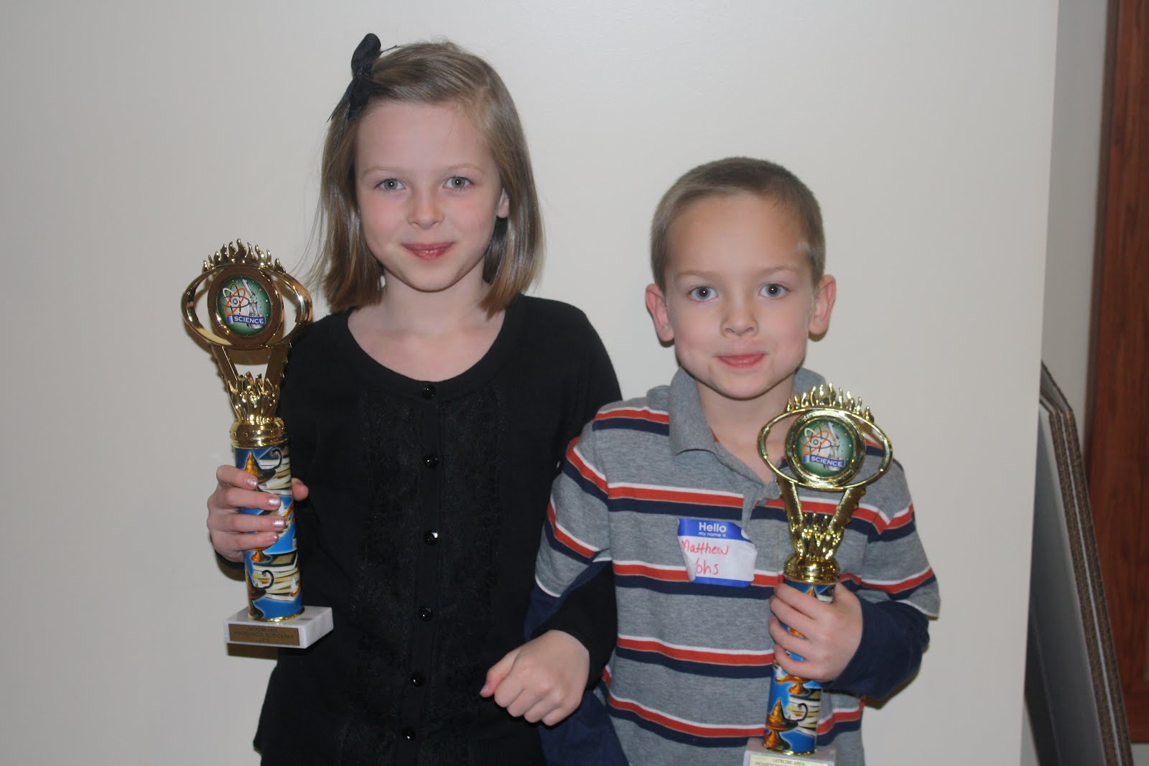

Slide 106
Strategies
Keep your focus on your healthy self – what you feel, think, and need – in the present and moving forward.
This focus does much to ensure that you will keep a healthy balance in care of self and others, and in doing so,
You will naturally not be so willing and able to shift from helping to hurting the person you simply want to help.

Slide 108
You and Your Internal Compass

Slide 109
You and Your Internal Compass
As we are coming to the end of our workshop, let’s put together what you have been studying and really attend to your Internal Compass.

Slide 111
You and Your Internal Compass
First, look back at your original reasons for participating in this session (Question #1) and what you hoped to learn here today (Question #2). How does what you have been taught and experienced in this workshop match what you wanted?

Slide 112
You and Your Internal Compass
Now, think of the person you identified in Question #3 as someone who challenges your Fine Line between helping and hurting. With that relationship in mind and what you have learned in this workshop:

Slide 113
You and Your Internal Compass
What will help you remember to connect with your Internal Compass when you are feeling like you want to keep offering and doing more for this person?

Slide 114
You and Your Internal Compass
What are Signs within you and indicators from this person that you are near The Fine Line and may shift to doing more than your helpful share for this person if you do not stay mindful of you, them, and larger goals for each of you?

Slide 115
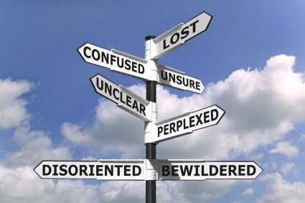

Slide 116
You and Your Internal Compass
How can you learn to trust your Internal Compass, to trust your “true North”?
Which of the 10 Strategies can help you stay on your course of offering help and knowing when to leave the rest to this other person?

Slide 118
Bibliography
Al-Anon Family Groups, Inc. (1981). Detachment (brochure). Virginia Beach, VA: Author.
Al-Anon Family Groups, Inc. (1987). One Day at a Time in Al-Anon (1987). Virginia Beach, VA: Author.
Al-Anon Family Groups, Inc. (1992). Courage to Change: One Day at a Time in Al-Anon. Virginia Beach, VA: Author.

Slide 119
Bibliography
American Psychological Association. (2014).”The Road to Resilience.” Washington DC: American Psychological Association. Retrieved from http://www.apa.org/helpcenter/road-resilience.aspx
Beattie, M. (2009). The New Codependency: Help and Guidance for Today's Generation. New York, NY: Simon &Schuster.
Central Recovery Press (2017). Discover Recovery. Las Vegas, NC: Central Recovery Press.

Slide 120
Bibliography
Greenberg, M. (2017). “8 Empowering Ways to Stop Feeling Guilty.” Retrieved from https://www.psychologytoday.com/us/blog/the-mindful-self-express/201703/8-empowering-ways-stop-feeling-guilty
Hanson, R. (2009). Buddha's Brain: The Practical Science of Happiness, Love, and Wisdom. Oakland, CA: New Harbinger Publications, Inc.
Hanson, R. (2013). Hardwiring Happiness: The New Brain Science of Contentment, Calm, and Confidence. New York, NY: Harmony Books.

Slide 121
Bibliography
Johnston, N. (2020). Disentangle: When You’ve Lost Your Self in Someone Else (2nd Ed.). Las Vegas, NV: Central Recovery Press.
Johnston, N. (2012). My Life as a Border Collie: Freedom from Codependency. Las Vegas, NV: Central Recovery Press.
Kabat-Zinn, J. (2013). Full Catastrophe Living (Revised/Updated). New York, NY: Bantam Books.

Slide 122
Bibliography
Lijewski, W. (2019). “Understanding Enabling Behavior and How to Handle It.” Retrieved from http://s3.amazonaws.com/EliteCME_WebSite_2013/f/pdf/PCUS02UE18.pdf
McKay, M., Wood, J., & Brantley, J. (2007). The Dialectical Behavior Therapy Skills Workbook. Oakland, CA: New Harbinger Publications, Inc.
Nhat Hanh, T. (1991), Peace is Every Step: The Path of Mindfulness in Everyday Life. New York, NY: Bantam Books.

Slide 123
Bibliography
Nhat Hanh, T. (1999). The Miracle of Mindfulness: A Manual on Meditation. Boston, MA: Beacon Press.
Speakman, M. (2014). The Four Seasons of Recovery. Rite of Passage Press.

